Slide 1

BA in Tech

Slide 2

What is BA in Tech?
What needs to be implemented
Focus on technicity for solution to requirement elicited
Induced risk defined forecasts by technical trading and fundamental analysis

Slide 3
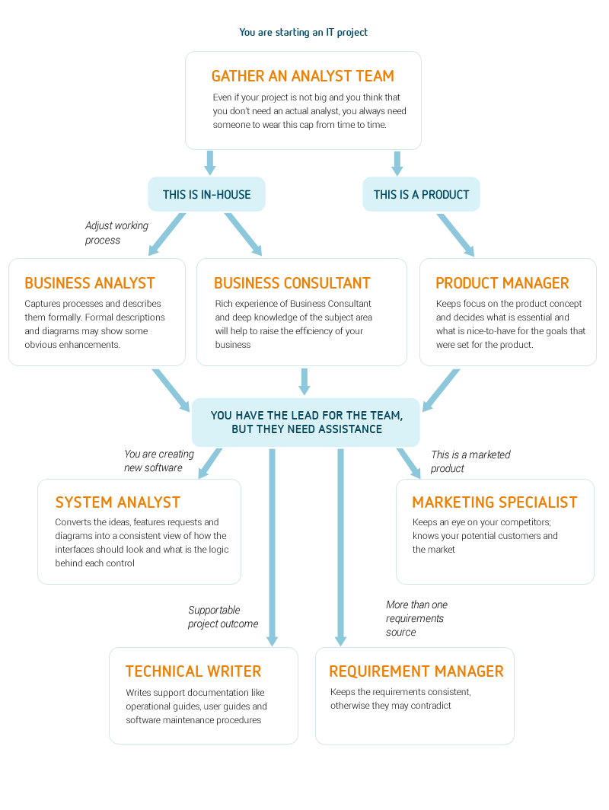
Data Flow

Slide 4
Responsibilities of BA in Tech
Data: collect and interpret data from many area within an organization to improve business process and finding solution to business.
Information flow: : Restricted to those who are conversant with the concept and have access to the required tools.
Analysis: it is the practice of analysing the price history of an instrument in order to make actionable, risk-defined forecasts of its future price.
Methods to Derive Stats: different technologies for the deriving output from the data by using charts, data mining techniques, patterns etc.

Slide 5
Steps Involved
Identifying current work
website
Project management application
New possible outcome
Increase productivity
Manage data
Latest tech offers
Data Mining
Remove communication gap
Digital Footprint
Customer experience Analytics

Slide 6
Flow of Mechanism
Creating, analyzing and validating detailed functional specifications
Facilitating design sessions with implementation team to define solution
Delivering element of system design like data migration, wireframes and business rules

Slide 7
Customer Analytics by Tech
Effort score
Satisfaction score
NPS
Brand loyalty
Customer churn
Feedback
Customer experience
Customer service
Customer engagement
Customer insights
Customer retention
Customer care
Customer acquisition

Slide 8
Tools used for Analysis
For Business Analysis | Customer Analytics
R programming | Medialla
Python | Whatfix
Tableau | Tealeaf
SAS | Zendesk
Excel | Censhare

Slide 9
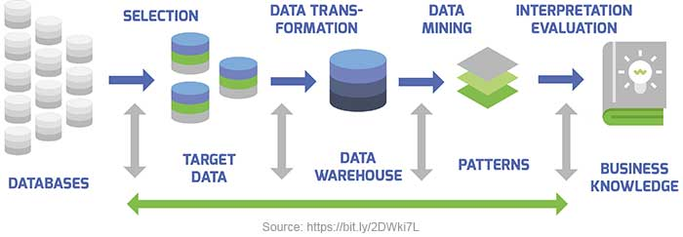
What can be done next?
For the analysis purpose, the suitable tool is R programming which can do data analysis and give output on based of that by using various algorithms.
Also it is easy to use and the output generated by the tool can help to find different solutions
The flow of the processing starts with the defining 0of the problem then preparing of the data and then evaluating the algorithm.
After that evaluating results based on that and finally presenting them and implementing them.
Lastly the matrix will be generated and on based of that predictions can be made.

Slide 10
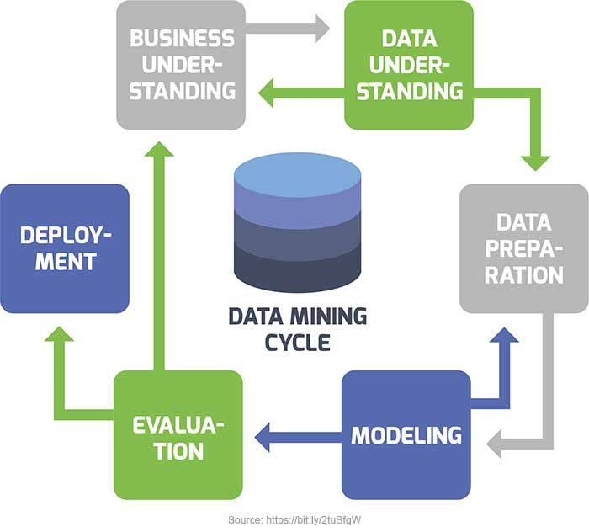

Slide 11
UNSUPERVISED DATA SET
IN R-LOAD PACKAGES AND DATA
Using R
Technical Data Processing
VALIDATE,SUMMARIZE AND VISUALIZE DATASET
IMPLEMEMTING ALGORITHMS AND MAKE PREDICTIONS

Slide 12

Sales Funnel
Top
-Lead
-Prospecting and Marketing
Middle
Sales Process
Qualified Prospect
Bottom
Committed
Transacted

Slide 13
Software's
Unbounce
Click funnels
LeadPages
OptimizePress
Thrive Leads

